Slide 1

Forecasting CO2 Level
Group - 6
Mentor Name: Mr. Parth
Date:
Prepared By
Mr.Alok
Mrs.Premavathi Kalliappan
Ms.Niyati Patel
Mrs.Sanvee Khot
Mr.Kunal Mahajan
Mrs.Tasleem

Slide 2
Business Problem
To forecast Co2 levels for an organization so that the organization can follow government norms with respect to Co2 emission levels.

Slide 3
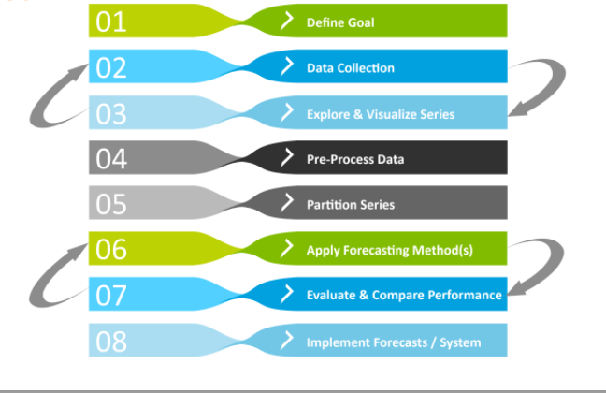
Forecasting Model Building Strategy

Slide 4
Data Collection

Slide 5
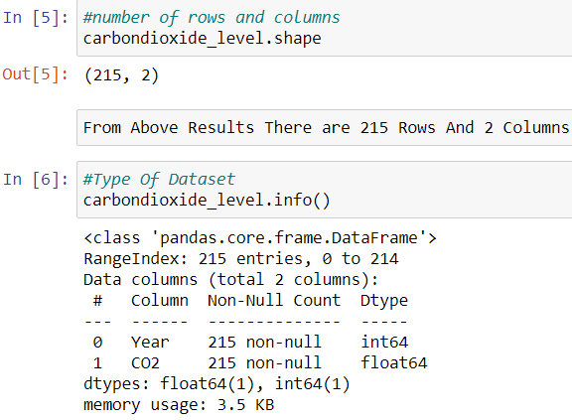
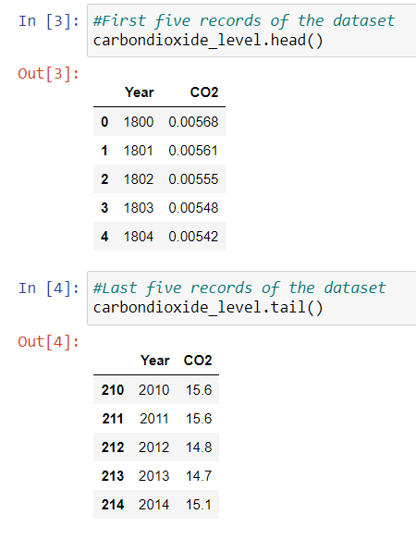
Understanding Data
Data information :
Below screen shot gives the first five records, last five records, numbers of rows and columns, data type of each columns

Slide 6
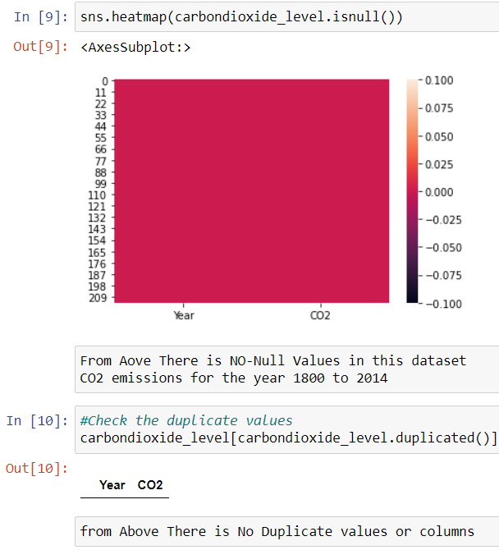
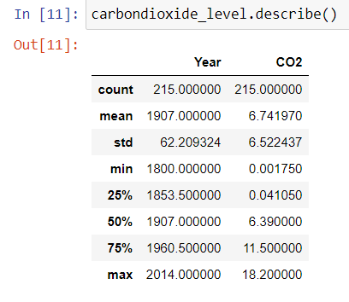
Understanding Data
g
There is No-Null Values And Duplicate Values in this dataset.

Slide 7
Visualization

Slide 8
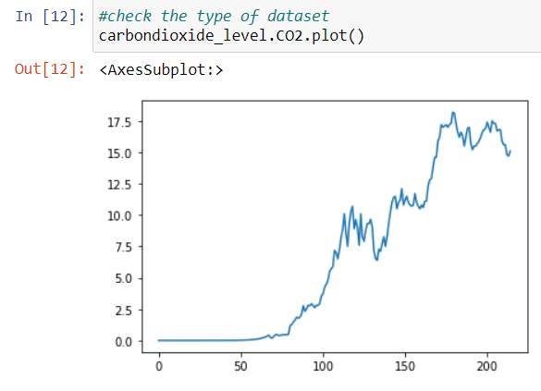
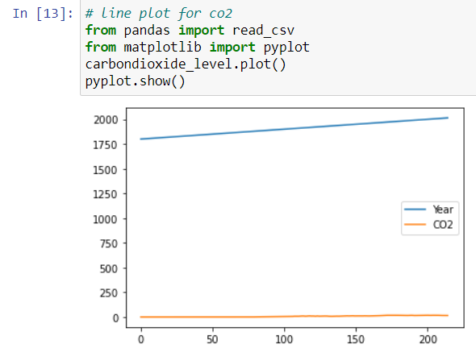
VISUALIZATION AND DECOMPOSITION OF DATA
Check the type of dataset by plotting and plot the line chart for Years and CO2.

Slide 9
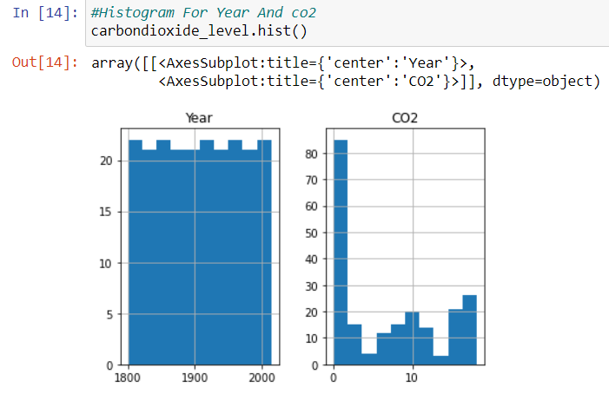
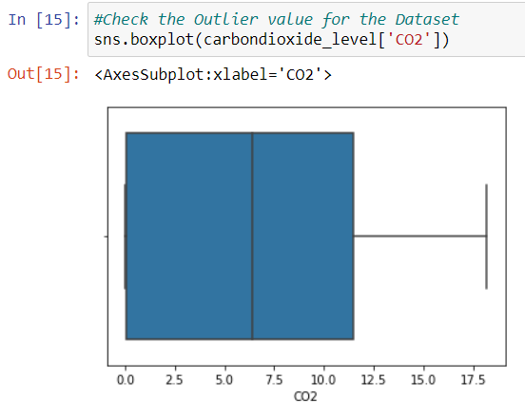
From the outlier there is no outlier values in this dataset.
The range of CO2 emission lies between 0 to around 18
VISUALIZATION AND DECOMPOSITION OF DATA

Slide 10
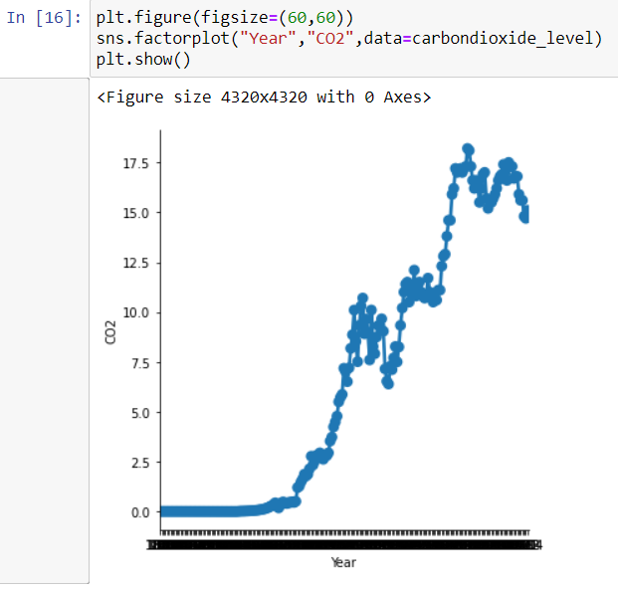
VISUALIZATION AND DECOMPOSITION OF DATA

Slide 11
Models

Slide 12
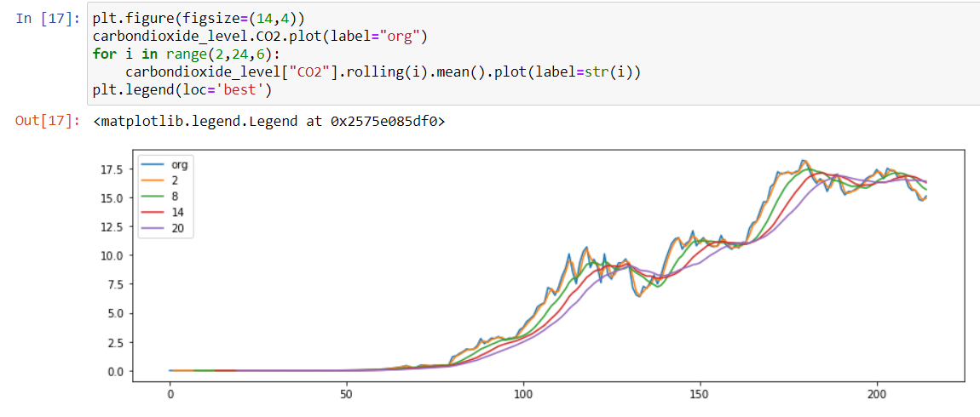
Data Driven models
Moving average
The emissions mean and the variation in standard deviation vary with time. This shows that the series has a trend. So, it is not a stationary.

Slide 13
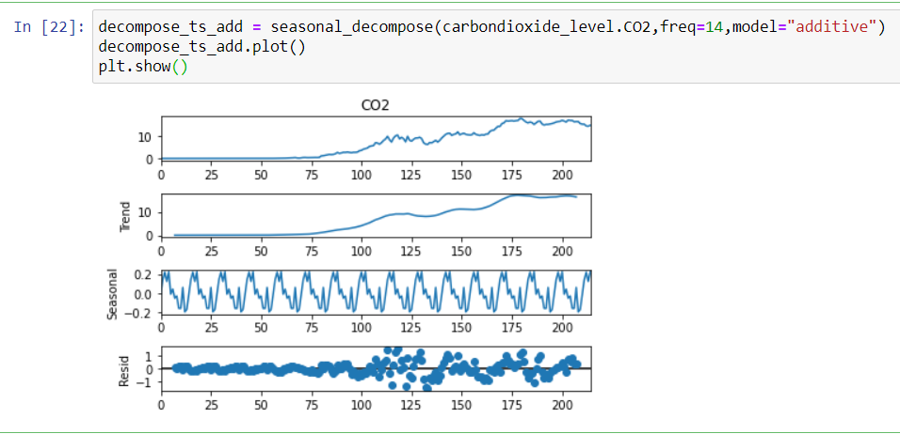
Time Series Decomposition plots

Slide 14
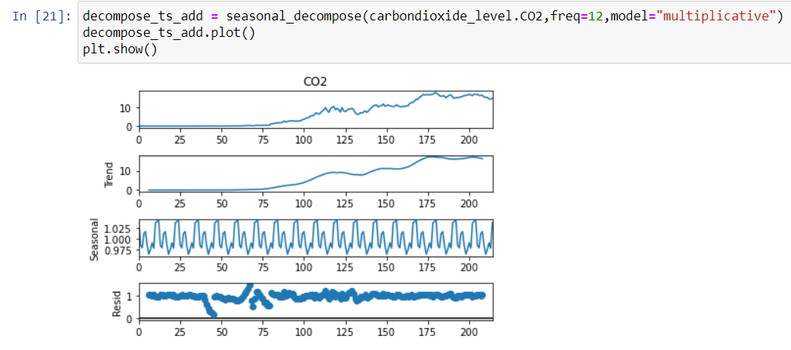
Time Series Decomposition plots
From the above decomposition plots, we can see there is a mulitplicative seasonality in our data
The above plots clearly shows that our data is not stationary.
The data is seasonal and shows an upward trend.

Slide 15
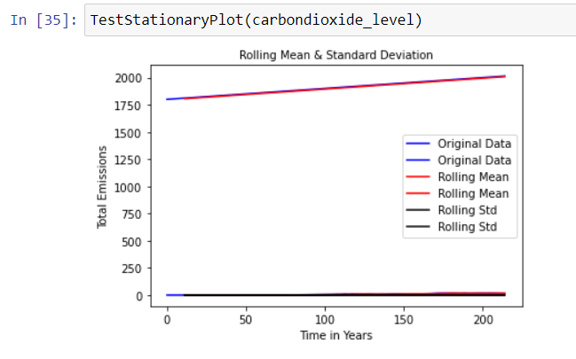
GRAPHICALLY TESTED STATIONARY
TestStationaryPlot

Slide 16
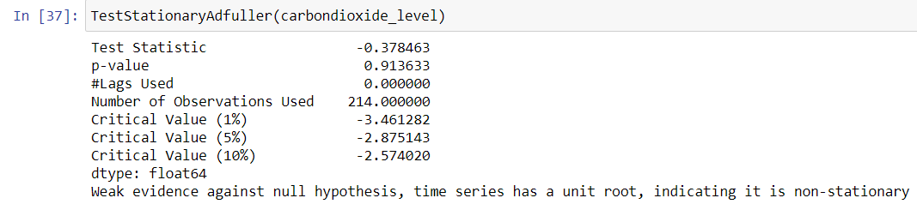
TEST STATIONARY USING DICKEY-FULLER

Slide 17
TO TRANSFORM THE DATASET INTO STATIONARY
The most common method of dealing with both trend and seasonality is differencing

Slide 18
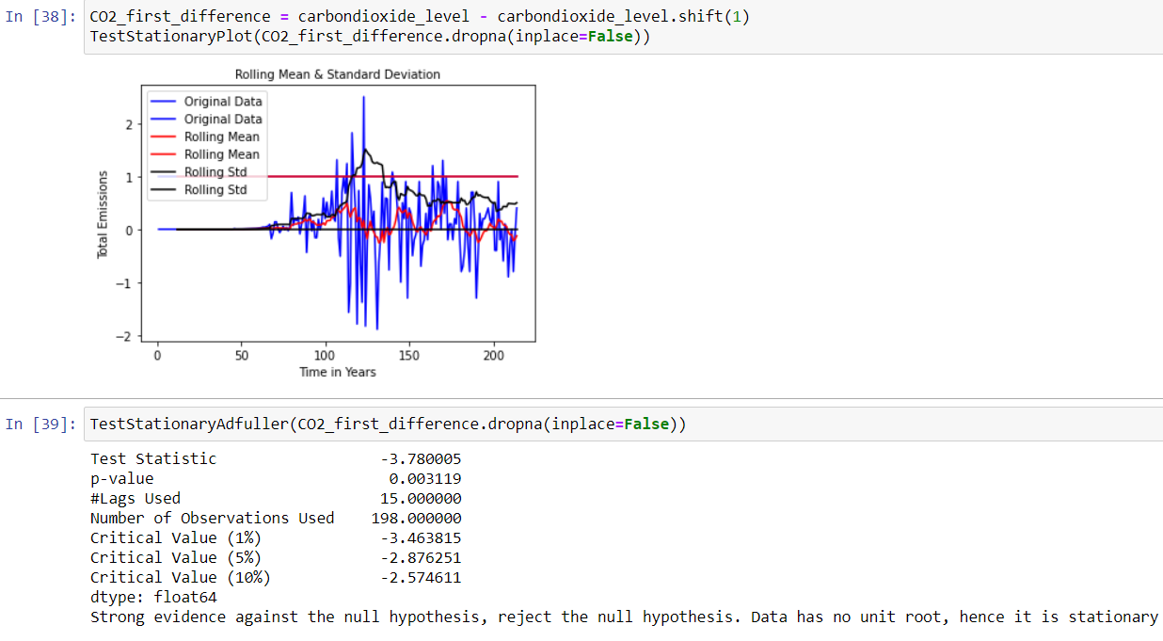
Eliminating trend and seasonality: Differencing
The first difference improves the stationarity of the series significantly.We also used the seasonal difference to remove the seasonality of the data and see how that impacts stationarity of the data.¶

Slide 19
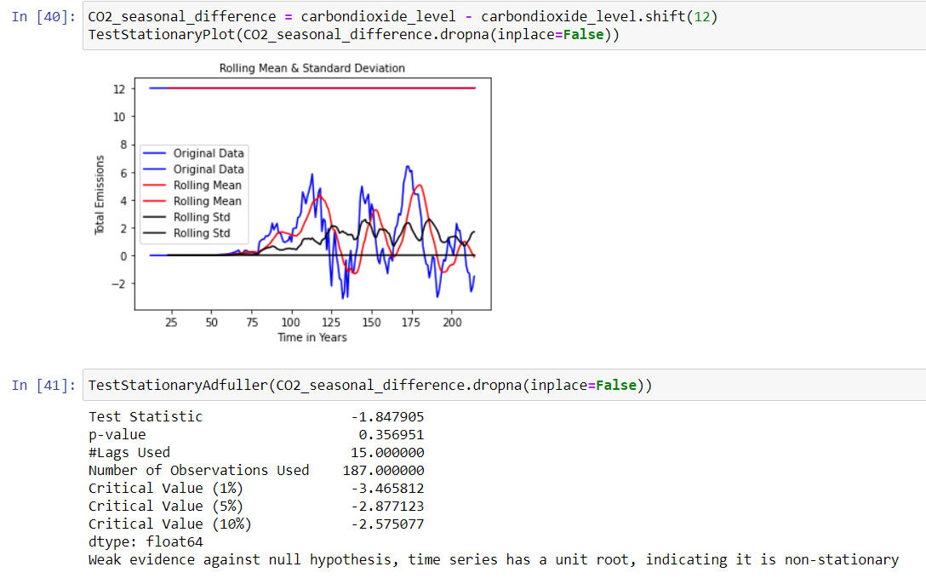
Eliminating trend and seasonality: Differencing

Slide 20
Eliminating trend and seasonality: Differencing

Slide 21
FIND OPTIMAL PARAMETERS AND BUILD ARIMA MODEL.
1.Number of Auto-Regressive (AR) terms (p)
2.Number of Moving Average(MA) terms (q)
3.Number of Differences (d)
Plot the ACF and PACF charts and find the optimal parameters
It is a measure of the correlation between the the time series (ts) with a lagged version of itself.

Slide 22
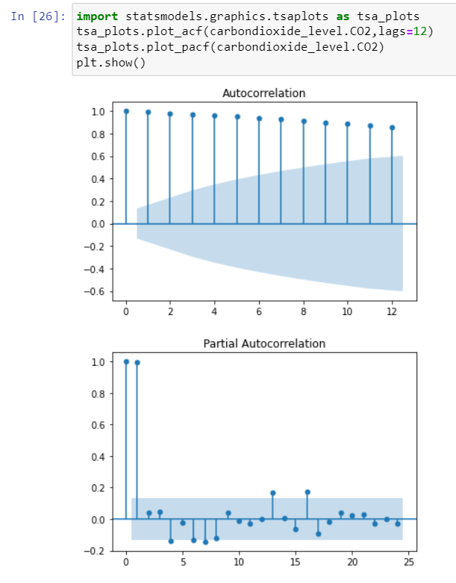
ACF and PACF plots

Slide 23
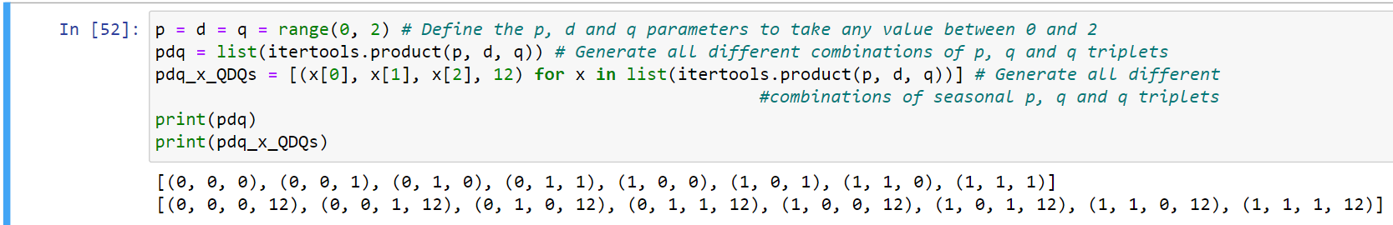
GRID SEARCH
To find the optimal parameters for ARIMA models using the graphical method is not trivial and it is time consuming. We will select the optimal parameter values systematically using the grid search (hyperparameter optimization) method. The grid search iteratively explore different combinations of the parameters.
The order argument specifies the (p, d, q) parameters, while the seasonal_order argument specifies the (P, D, Q, S) seasonal component of the Seasonal ARIMA model. After fitting each SARIMAX()model, the code prints out its respective AIC score

Slide 24
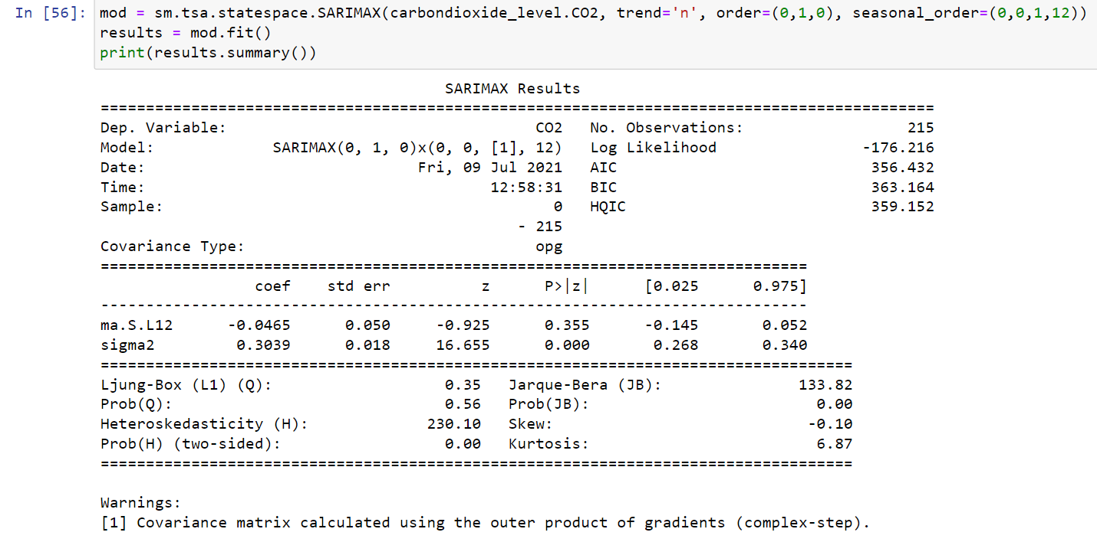
AIC (Akaike Information Criterion) value
AIC will choose the best model from a set(The “best” model will be the one that neither under-fits nor over-fits.),then consider running a hypothesis test to figure out the relationship between the variables in your model and the outcome of interest.

Slide 25
The co2 column shows the weight (i.e. importance) of each feature and how each one impacts the time series. The P>|z| column informs us of the significance of each feature weight. Here, each weight has a p-value close to 0, so it is reasonable to include the features in our model.
Get a line plot of the residual errors, suggesting that there may still be some trend information not captured by the model.

Slide 26
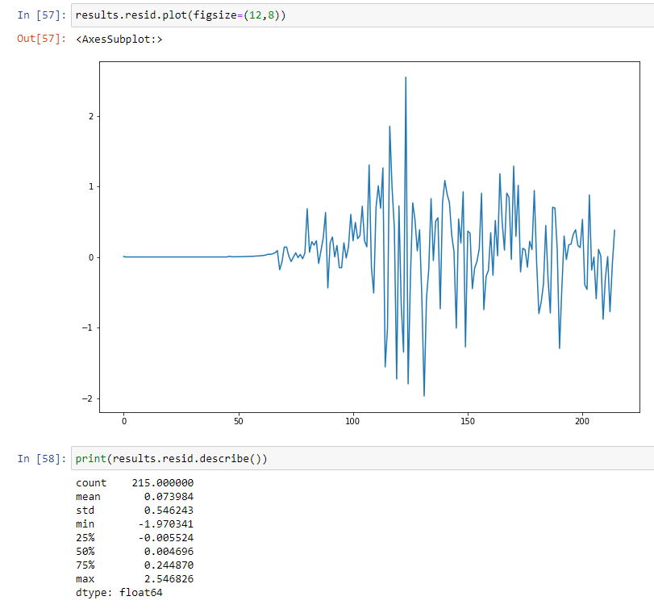
The figure displays the distribution of the residual errors. It shows a little bias in the prediction
we get a density plot of the residual error values, suggesting the errors are Gaussian, but may not be centered on zero

Slide 27
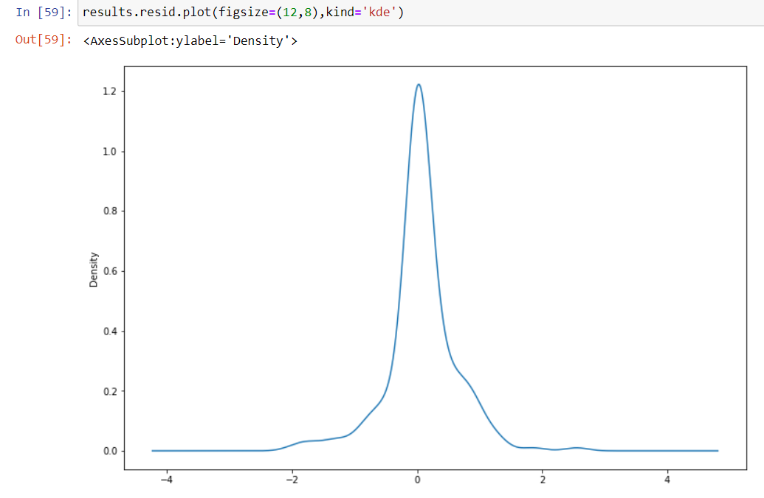

Slide 28
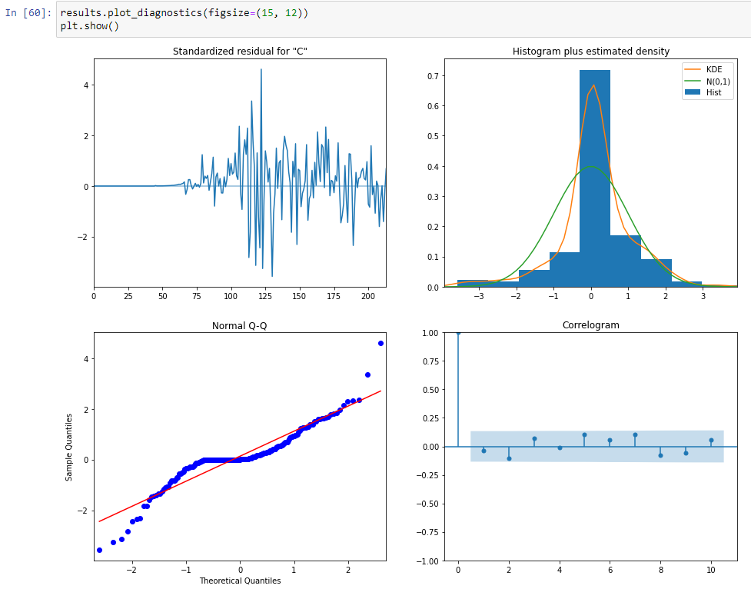
Results Plot Diagnostics

Slide 29
The model diagnostic suggests that the model residual is normally distributed based on the following:
In the top right plot, the red KDE line follows closely with the N(0,1) line. Where, N(0,1) is the standard notation for a normal distribution with mean 0 and standard deviation of 1. This is a good indication that the residuals are normally distributed. The forecast errors deviate somewhat from the straight line, indicating that the normal distribution is not a perfect model for the distribution of forecast errors, but it is not unreasonable.
The qq-plot on the bottom left shows that the ordered distribution of residuals (blue dots) follows the linear trend of the samples taken from a standard normal distribution. Again, this is a strong indication that the residuals are normally distributed.
The residuals over time (top left plot) don't display any obvious seasonality and appear to be white noise. This is confirmed by the autocorrelation (i.e. correlogram) plot on the bottom right, which shows that the time series residuals have low correlation with lagged versions of itself.

Slide 30
Validating Prediction
We will compare predicted values to real values of the time series, which will help us understand the accuracy of our forecast.
Forecasting
The forecasting methods we will cover following methods:
Seasonal Naive
Triple Exponential Smoothing (Holt Winter's)
SARIMA
Linear Model
Exponential Smoothing
Quadratic Model

Slide 31
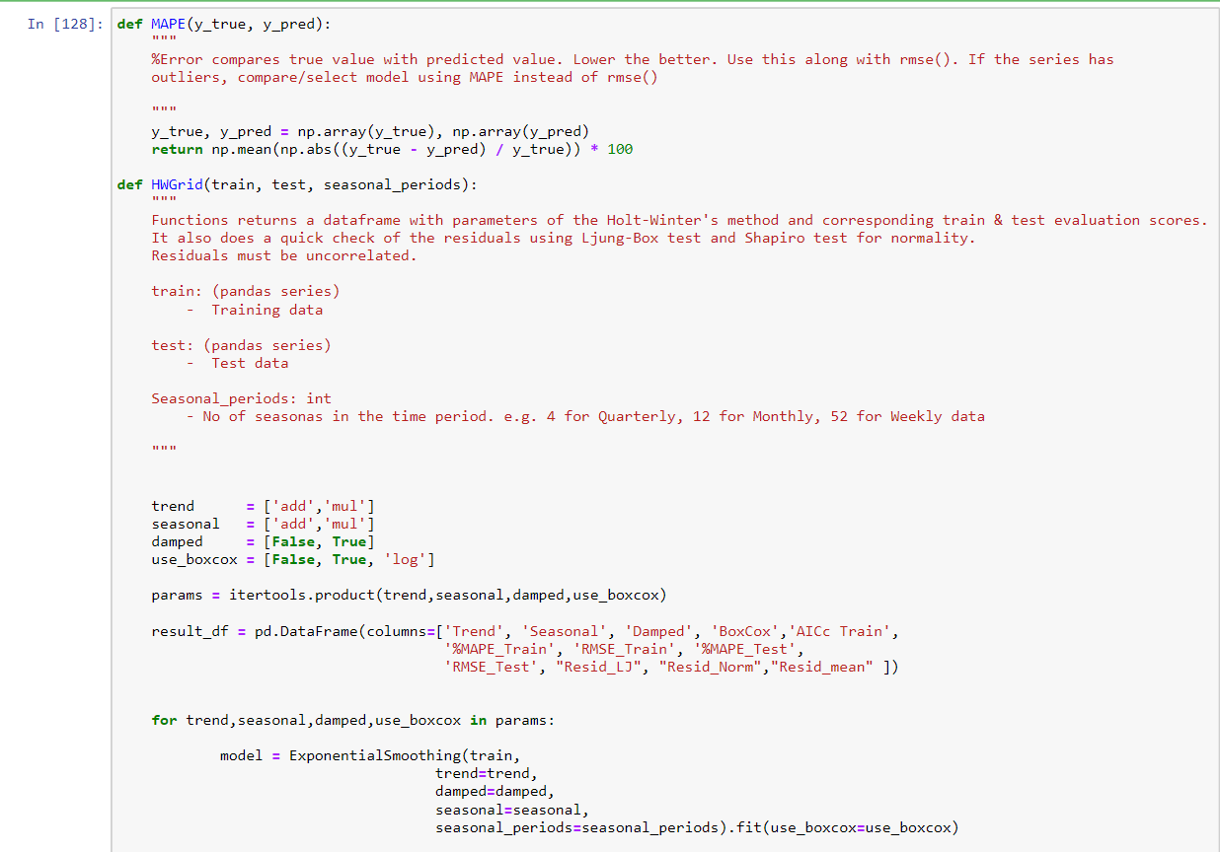
Various Functions Used
custom functions we write for forecast accuracy, gridsearching, residual diagnostics.

Slide 32
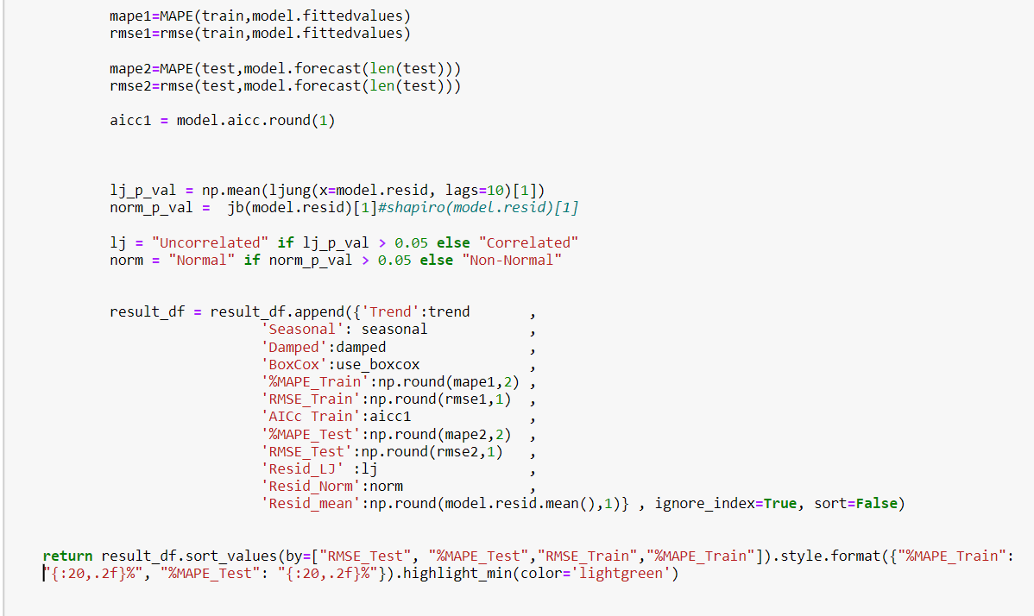

Slide 33
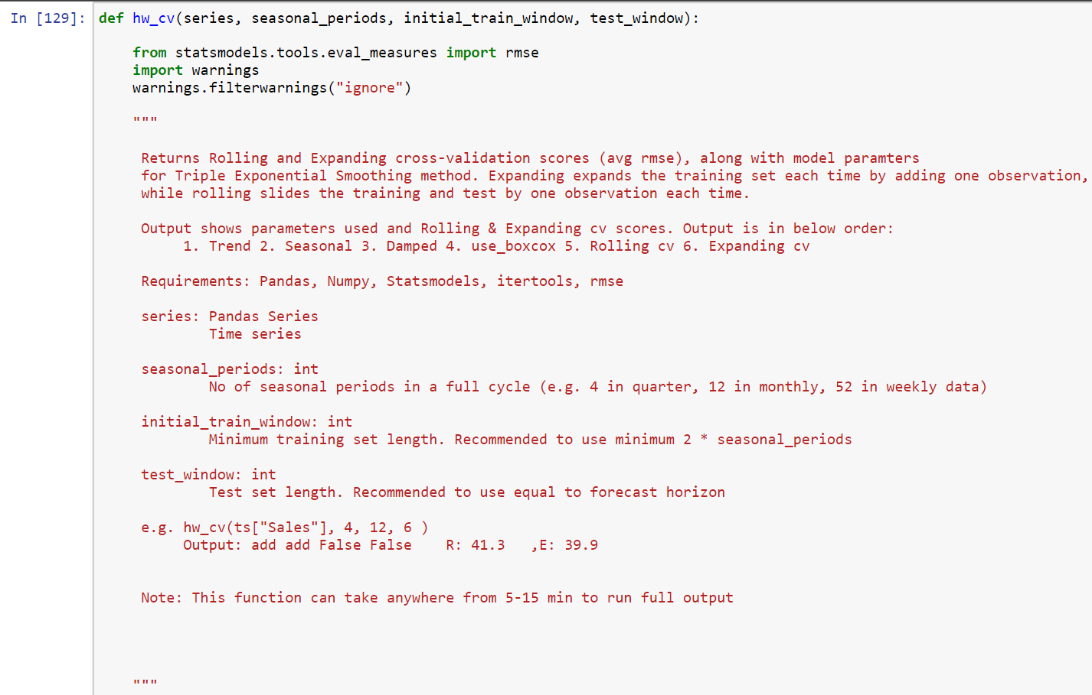
Calculating cross-validation score for Holt-Winter's method in Python

Slide 34
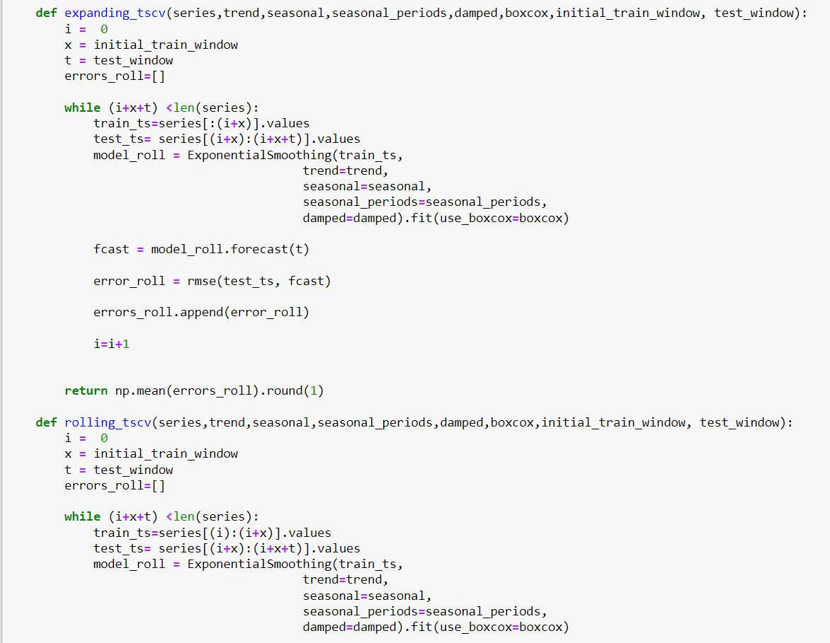

Slide 35
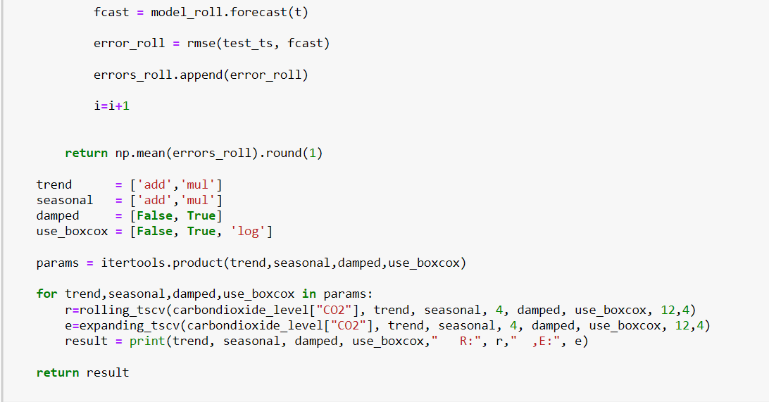

Slide 36
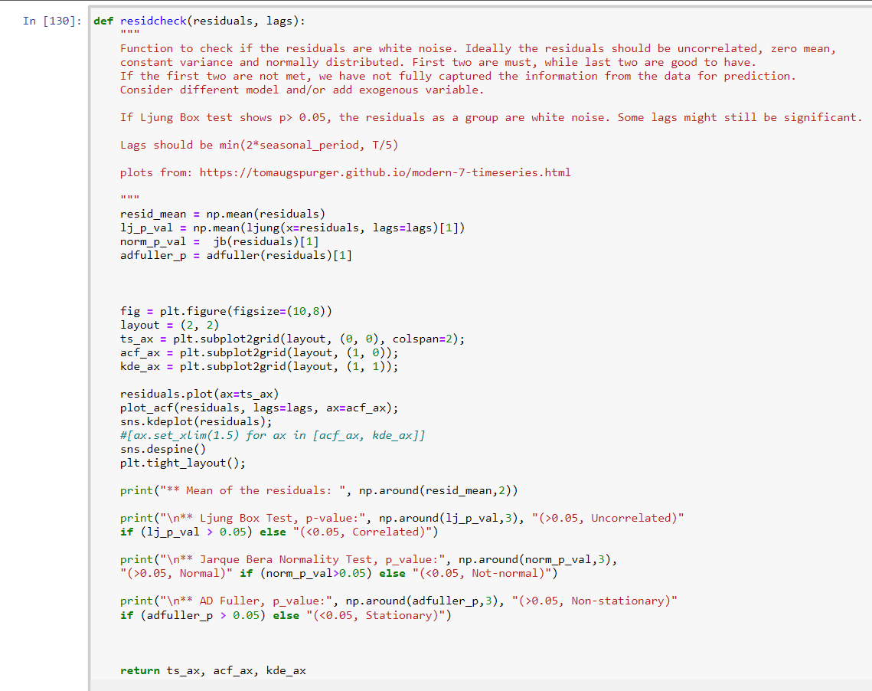
Function for residual diagnostics

Slide 37
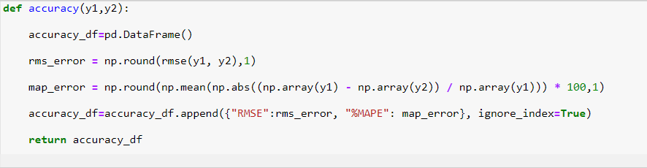
Function for calculating RMSE & %MAPE

Slide 38
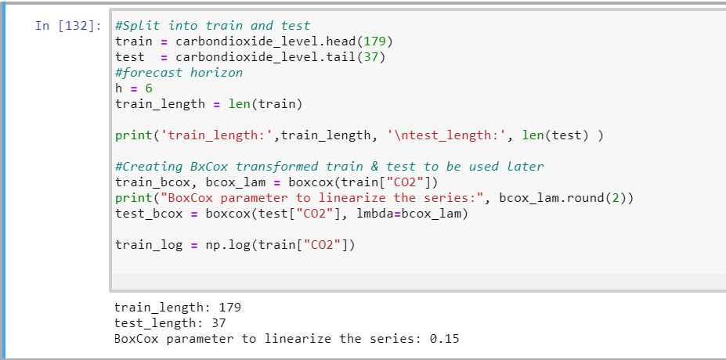
Train Test Split :

Slide 39
Seasonal Naive :
This method is not available in statsmodels library so we write a function for it.
Before we create the model, we are going to create a dataframe to store all out-of-sample forecasts and the test set.
Fitted the valuess
Forecast the values
Residuals for the values

Slide 40
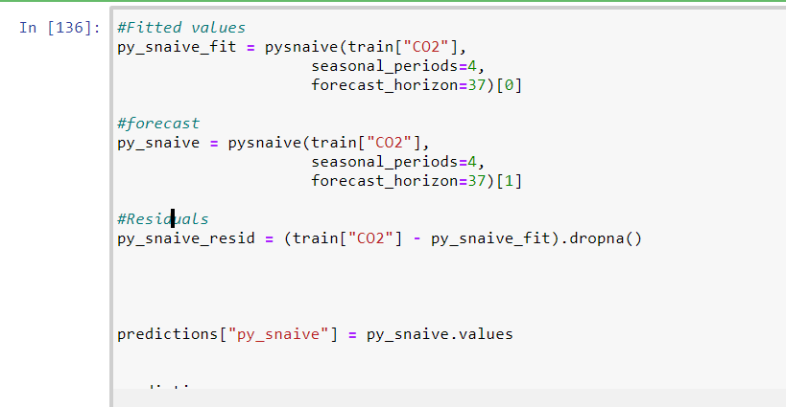

Slide 41
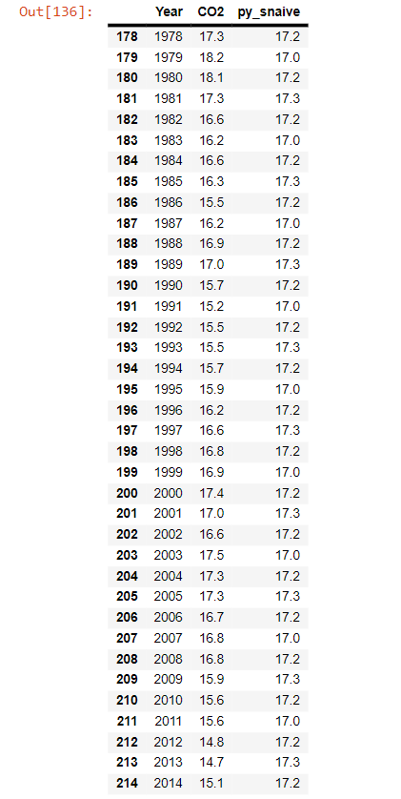

Slide 42
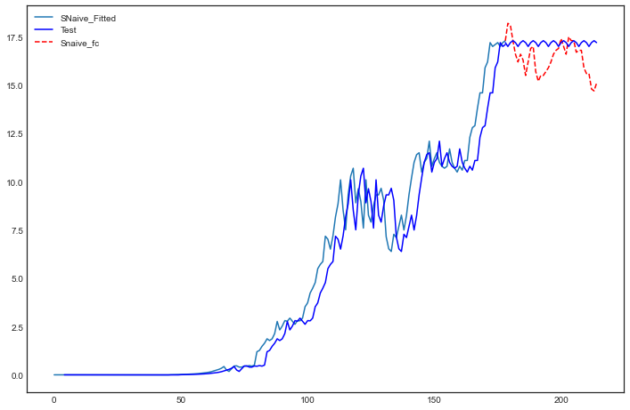
pd.plotting.register_matplotlib_converters()
train["CO2"].plot(figsize=(12,8))#, style="--", color="gray", legend=True, label="Train")
py_snaive_fit.plot(color="b", legend=True, label="SNaive_Fitted")
predictions["CO2"].plot(style="--",color="r", legend=True, label="Test")
predictions["py_snaive"].plot(color="b", legend=True, label="Snaive_fc");

Slide 43
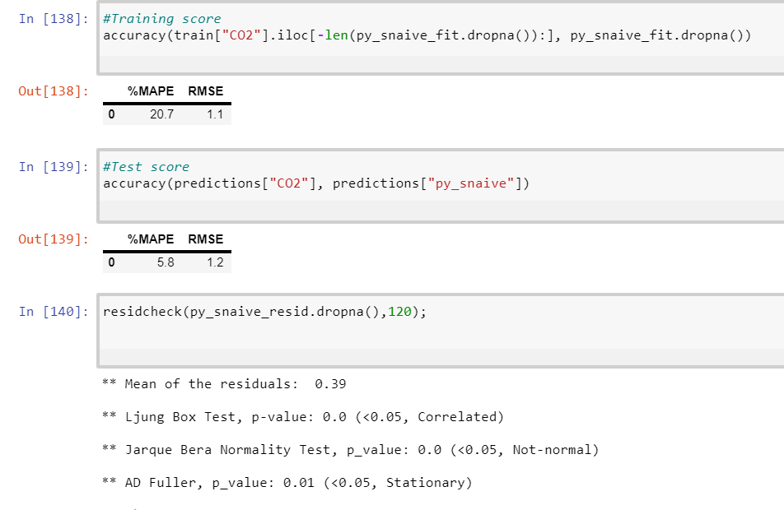
Training Score And Test Score And Residual For Dataset

Slide 44
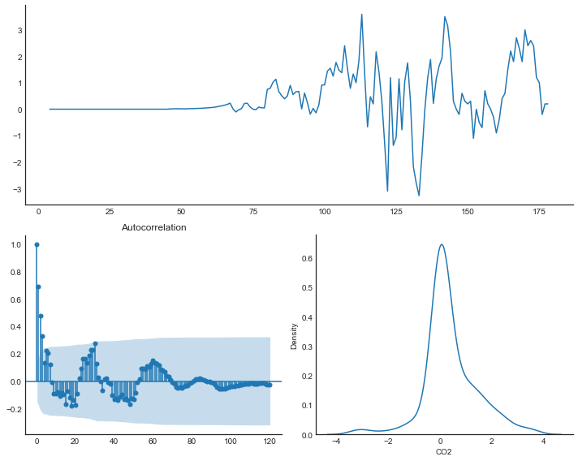

Slide 45
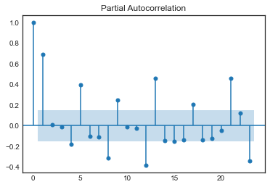
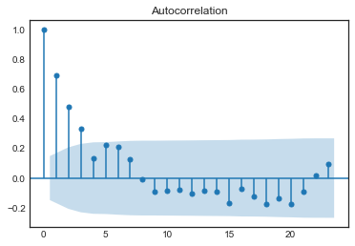
PACF of Seasonal Snaive Model Residuals
plot_acf(py_snaive_resid);
plot_pacf(py_snaive_resid);

Slide 46
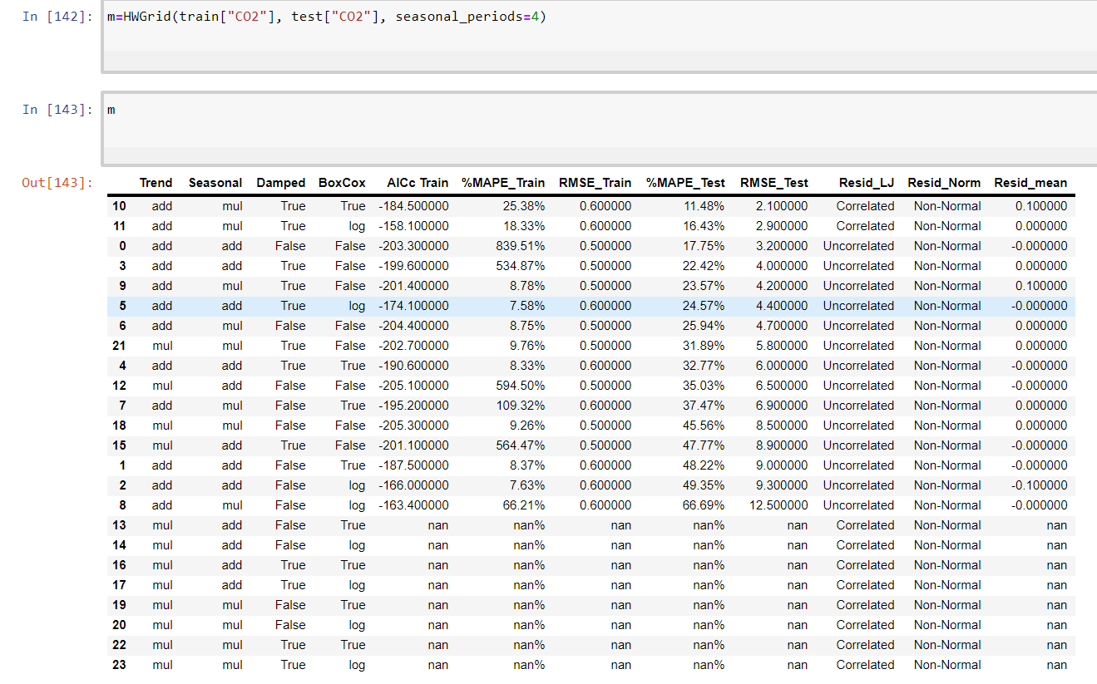
Grid Searching Triple Exponential Smoothing (Holt-Winter's Method)

Slide 47
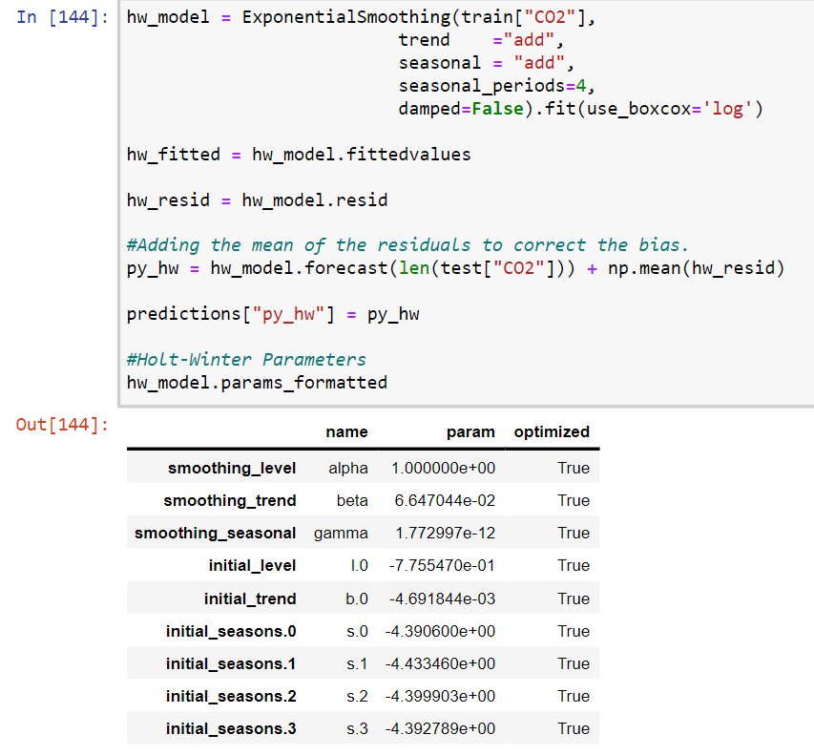
Holt-Winter's Model

Slide 48
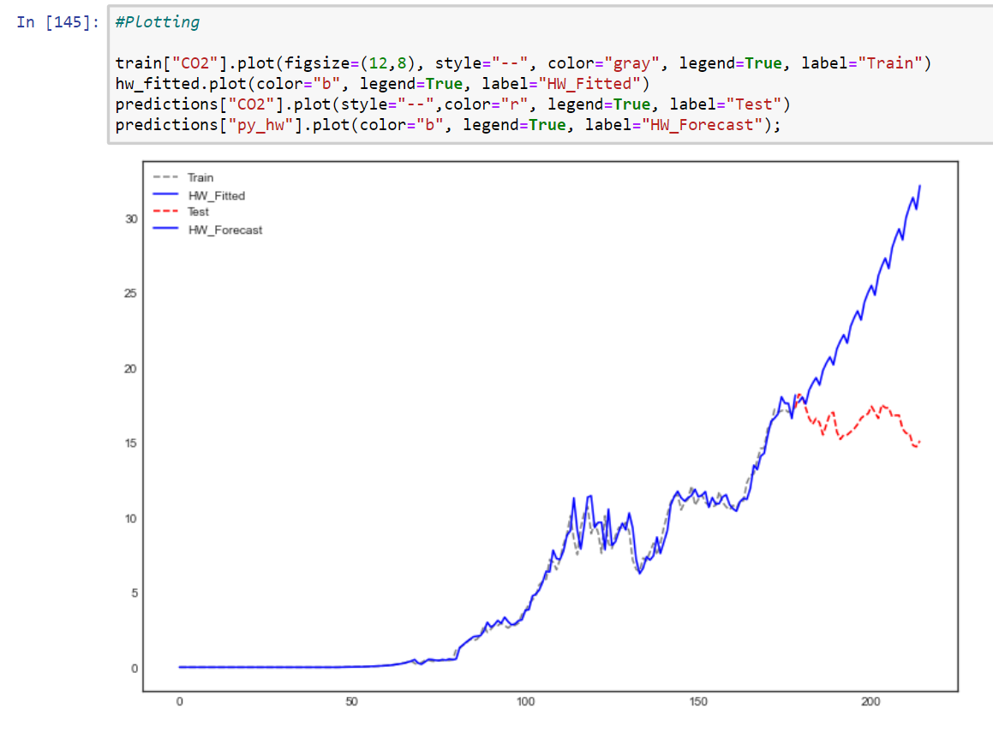
Plotting

Slide 49
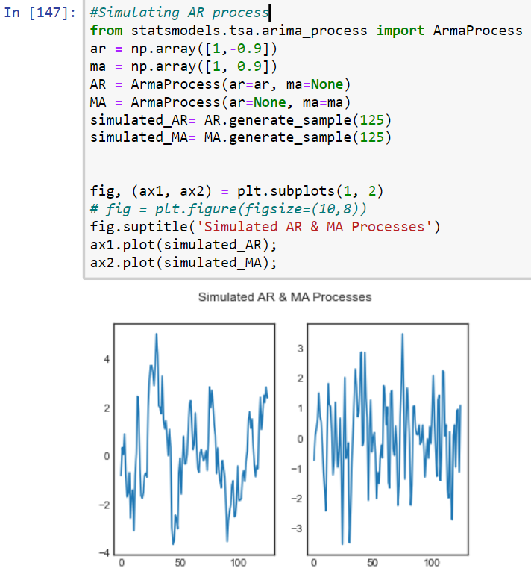
Simulating AR process

Slide 50
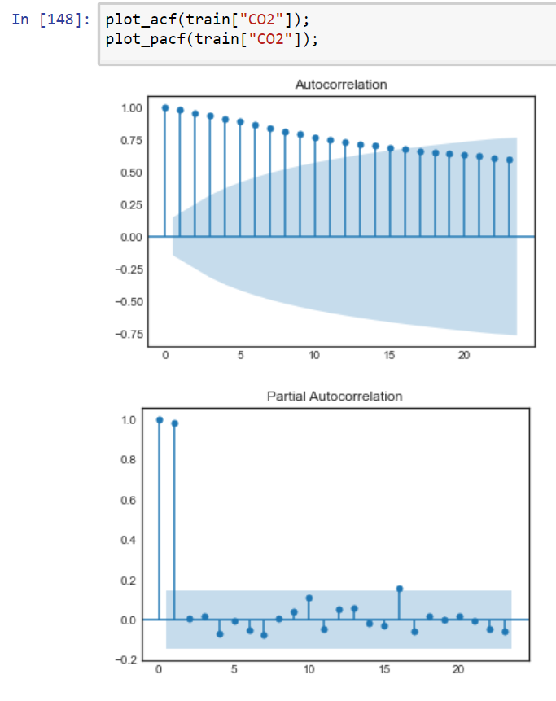
Plot ACF And PACF

Slide 51
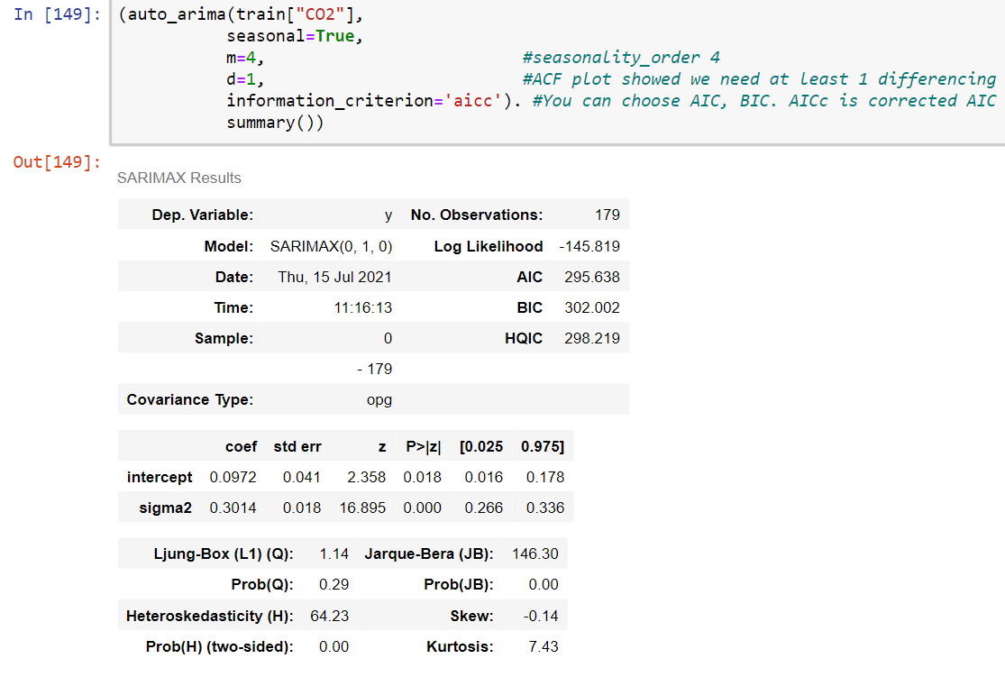
Auto-Arima

Slide 52
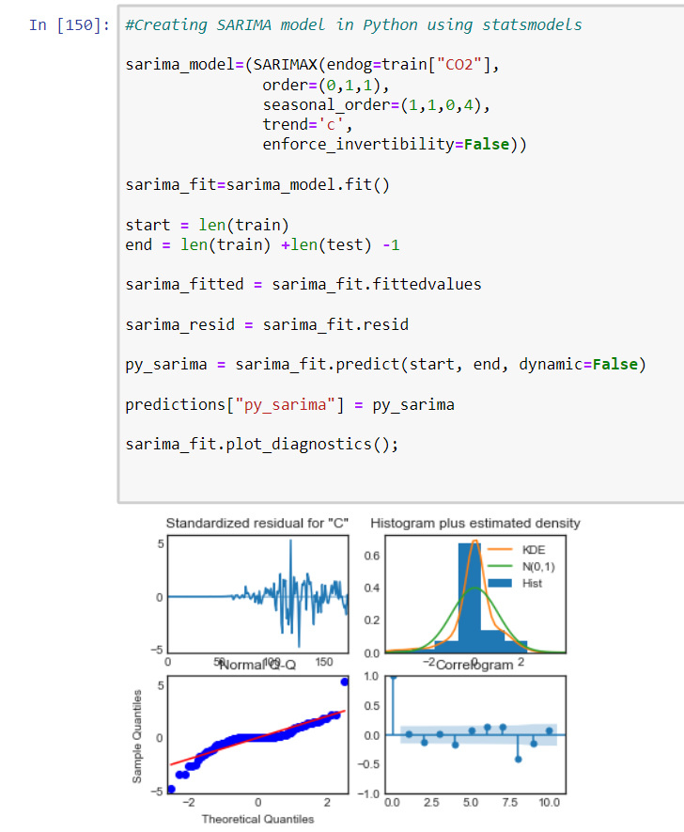
Creating SARIMA Model In Python Using StatsModels

Slide 53
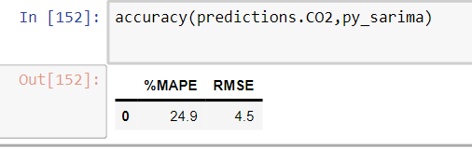
Check The Accuracy(predictions.CO2,py_sarima)

Slide 54
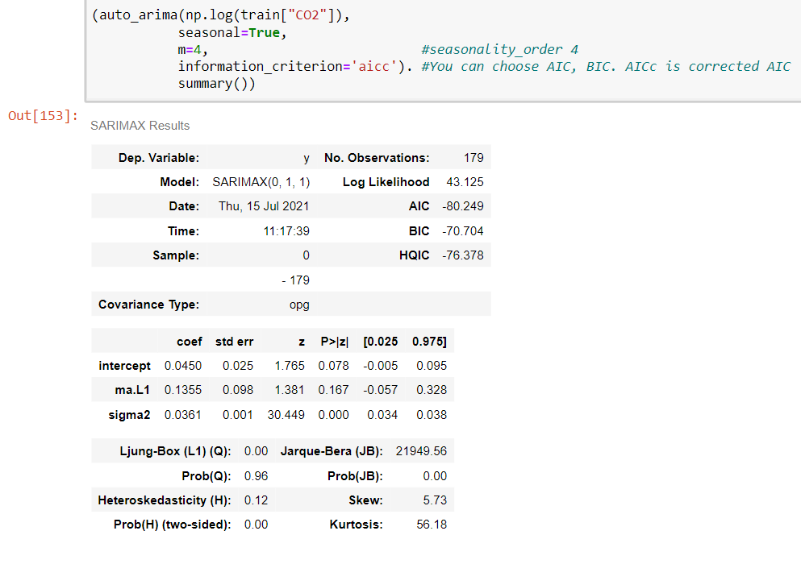
Fitting Model To Log Of Train

Slide 55
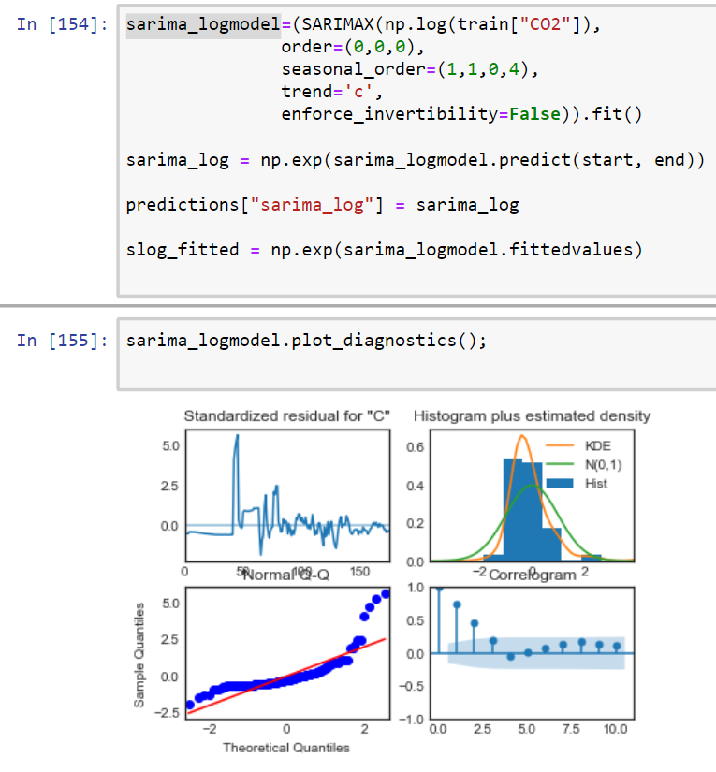
Sarima-Log-Model

Slide 56
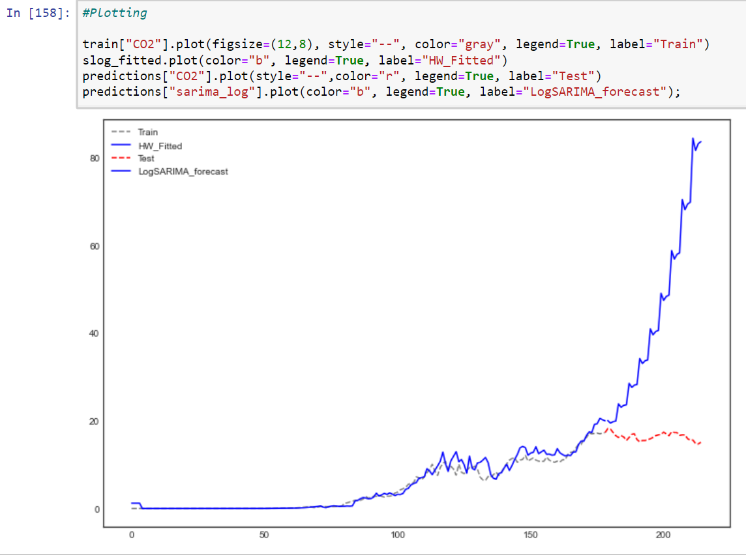
Plotting

Slide 57
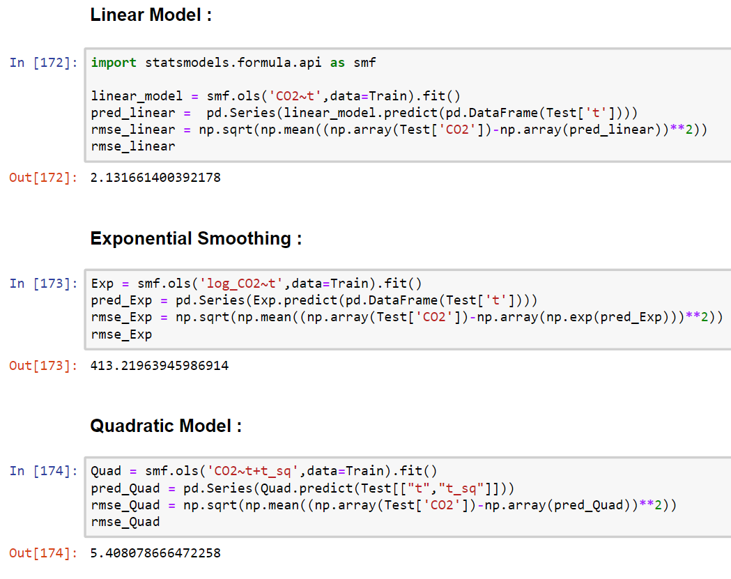

Slide 58


Prediction

Slide 59


Forecasts

Slide 60
Conclusion
Conclude that our model produces a satisfactory fit that could help us understand our time series data and forecast future values.

Slide 61
VALIDATING PREDICTION
We will compare predicted values to real values of the time series, which will help us understand the accuracy of our forecast.

Slide 62
Thank You

